Slide 1
Pipeline for differential expression

Slide 2
Introduction
Background
Project kick-off
Pipeline
Planning

Slide 3
Background
Project: Differential gene expression

Slide 4
Project-kickoff
Discussed:
Biological framework of the pipeline
Assign priorities to the parts of the pipeline
Draft planning
Source control and project management

Slide 5
Project-progress
MoSCoW list

Slide 6
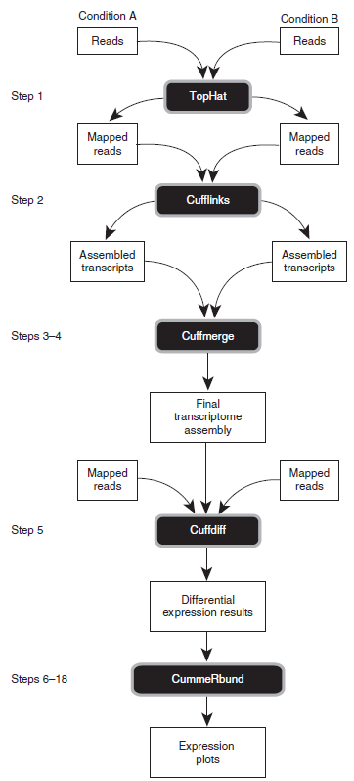
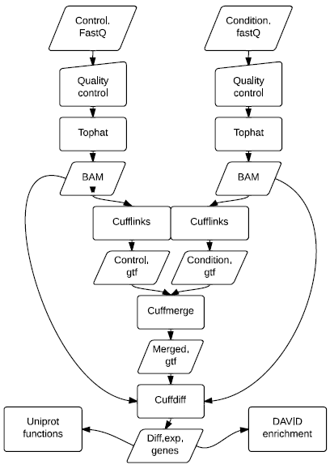
Project-kickoff – Pipeline Backbone
Reference to paper
Proposed pipeline backbone

Slide 7
Project-progress
Run suggested protocol on server 15
Become familiar with the different components of the pipeline and the pipeline as a whole
Evaluate it for backbone usage
Creating a set of training files we can use to program each individual step
Compare the scientific results from the paper

Slide 8
Project-planning
Liquidplanner needs to be updated for this I suppose. Will work at this later.

